Slide 1
LUMC Mental Health Series
Spring 2025

Slide 2
disclosures
These sessions are for educational and informational purposes only and do NOT constitute a provider-patient relationship. Information shared during these sessions does not constitute medical and/or psychological advice.
Mental health professionals who lead these sessions are mandated reporters and are required by law to disclose information/concerns about self-harm, harm to others, and abuse/neglect of children or vulnerable persons to appropriate emergency services/protective services.
Resources on accessing care will be provided to all session attendees. If you have concerns about your own or a loved one’s mental health, you are strongly encouraged to reach out to appropriate medical and/or mental health providers.

Slide 3
Addiction
LUMC Mental Health Series
February 23, 2025

Slide 4
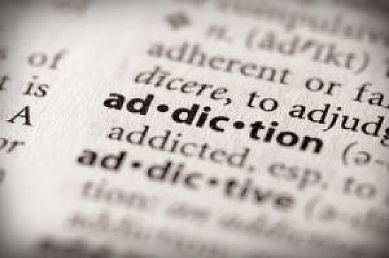
What is “Addiction”?
Addiction is a state of psychological and/or physical dependence on the use of drugs or other substances, such as alcohol, or on activities or behaviors, such as sex, exercise, and gambling.
Substance use disorder is a cluster of physiological, behavioral, and cognitive symptoms associated with the continued use of substances despite substance-related problems, distress, and/or impairment, such as impaired control and risky use.
Adapted from the APA Dictionary of Psychology

Slide 5
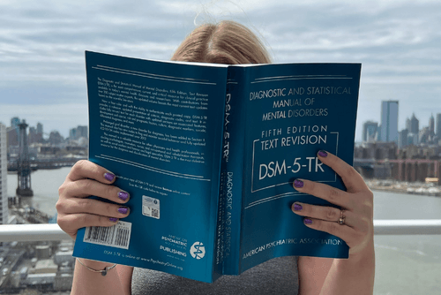
Definitions
According to the DSM-5-TR (the manual that psychologists use to diagnose disorders):
“Addiction” is not used due to negative connotations that can prevent people from seeking help.
“Substance use disorder” applies to 10 separate classes of drugs: alcohol; caffeine; cannabis; hallucinogens; inhalants; opioids; sedatives, hypnotics; stimulants; and tobacco.
All drugs that are taken in excess directly activate the brain reward systems.
“Gambling disorder” evidence that gambling behaviors activate reward systems similar to those activated by drugs of abuse and that produce some behavioral symptoms that resemble those of SUDs.
“Internet gaming disorder” is included as a condition for further study due to the need for further research.
“Behavioral addictions” (sex, exercise, shopping, phone use) are not included because the research is less clear.
Source: American Psychiatric Association (2022)

Slide 6
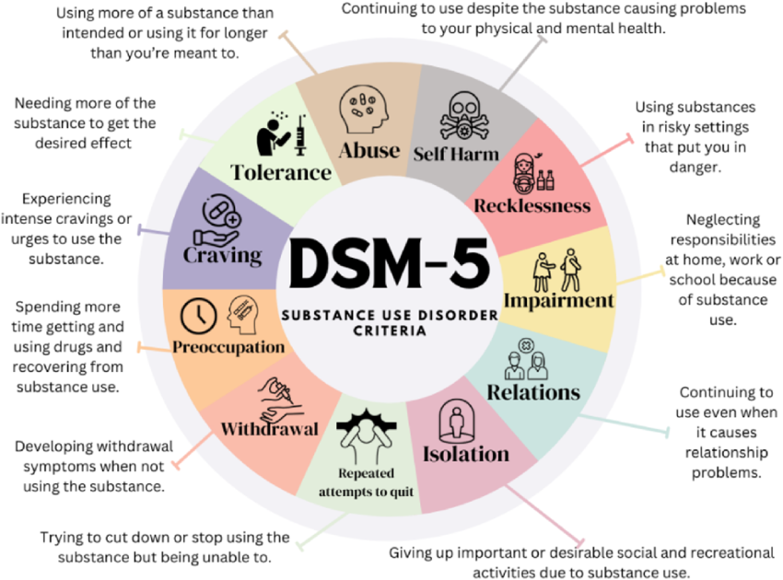

Slide 7
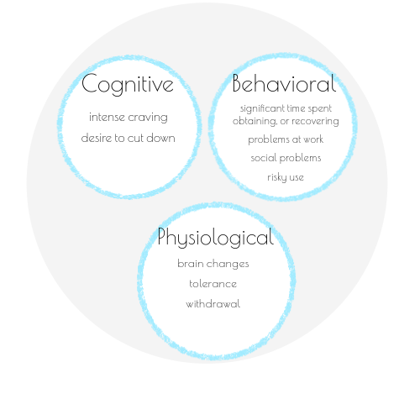
Substance Use Disorder
The essential feature is a cluster of cognitive, behavioral, and physiological symptoms indicating that the person continues to use the substance despite significant substance-related problems.
It is a pattern of repetitive behavior that is unhealthy and maladaptive - these negative consequences are not enough for some people to stop these behaviors.
An important characteristic of SUDs is the underlying change in brain circuits that may persist beyond detoxification (repeated relapse and intense cravings when around cues).
Source: American Psychiatric Association (2022)

Slide 8
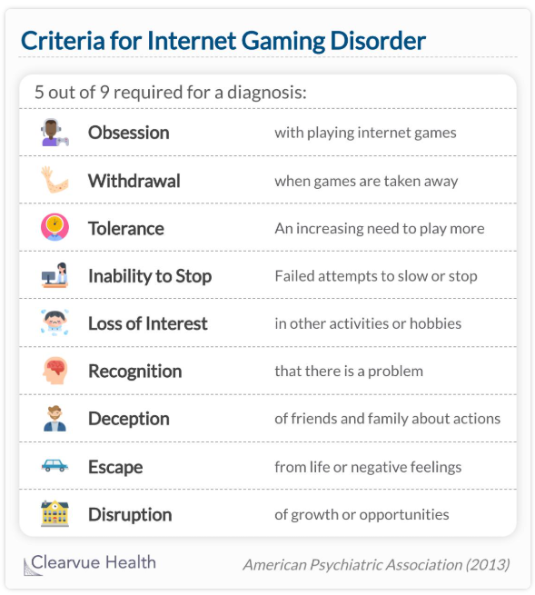
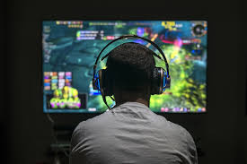
Internet Gaming Disorder
Significant impairment or distress as indicated by the following symptoms within a 12-month period. This is not intended to include social internet use or sexual internet sites.
4.7% of people internationally meet these criteria (4.6% of adolescents age 10-19).
Higher rates among boys (6.8%) than girls (1.3%).
Source: American Psychiatric Association (2022)

Slide 9
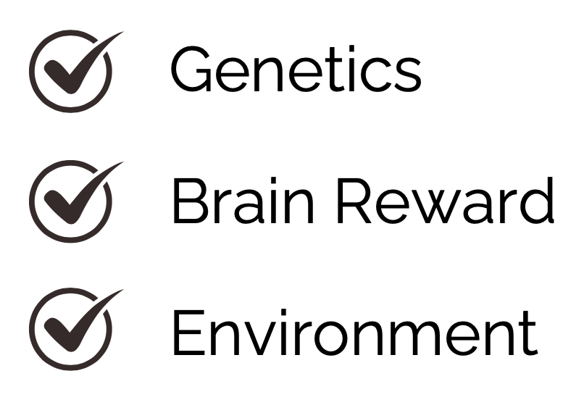
Factors of Addiction
Addiction is caused by a combination
of factors that affect the brain and a
person's behavior.

Slide 13
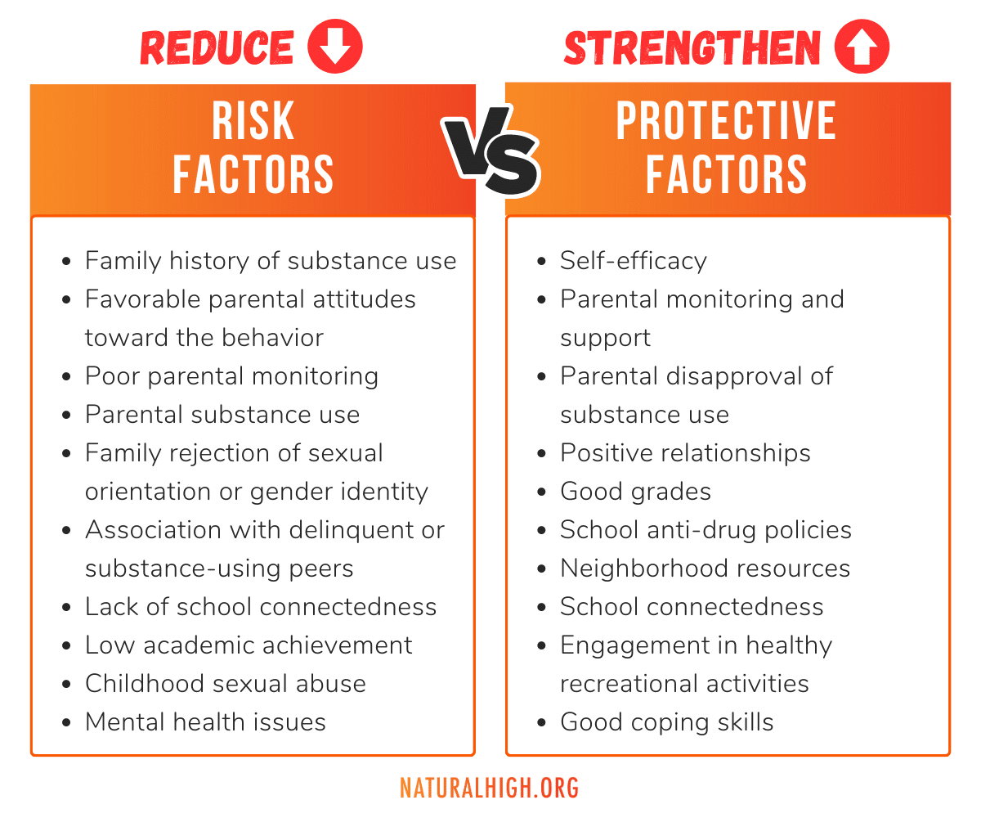

Slide 14
How Does “Addiction” Happen?
The reward pathway/pleasure pathway in the brain explained by Dr. Anna Lembke.

Slide 15
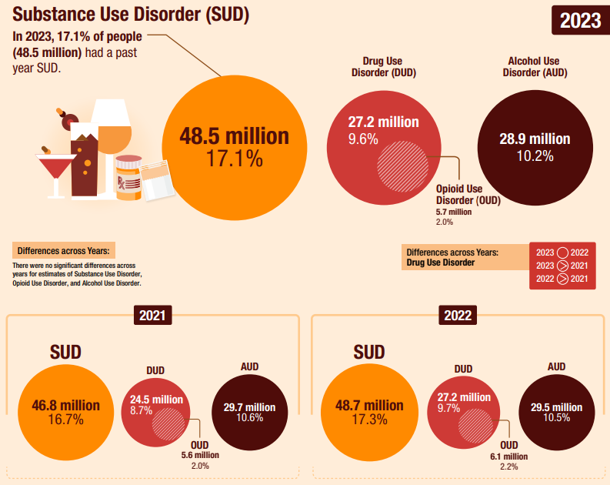
Prevalence of Substance Use Disorder
Source: Substance Abuse and Mental Health Services Administration (2024)

Slide 16
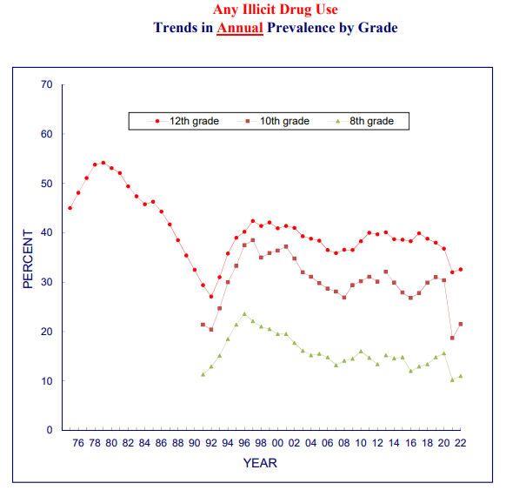
Substance Use in Youth
Use of illicit substances has remained low compared to pre-pandemic levels.
The decrease in 2020-2021 is attributed to social distancing and school closures.
Overdose rates are at an all time high.
2010: 518 overdose deaths among adolescents (2.40 per 100,000 population).
Through 2019: Rates remained stable with 492 deaths (2.36 per 100,000).
2020: Deaths increased to 954 (4.57 per 100,000).
2021: Deaths increased to 1146 (5.49 per 100,000) in 2021.
Source: Friedman, J. et al. (2022), Miech, R.A. et al. (2023), NIH (2023)

Slide 17
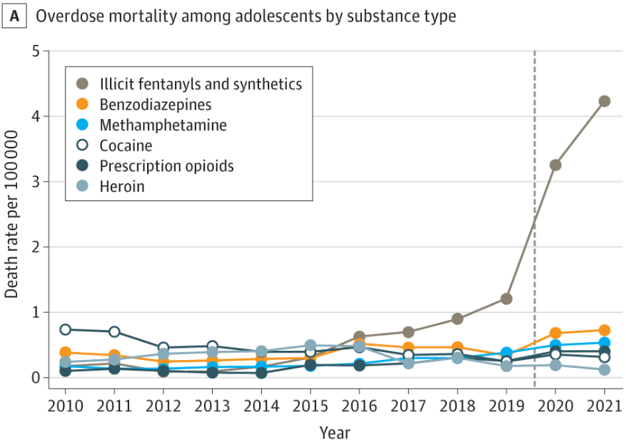
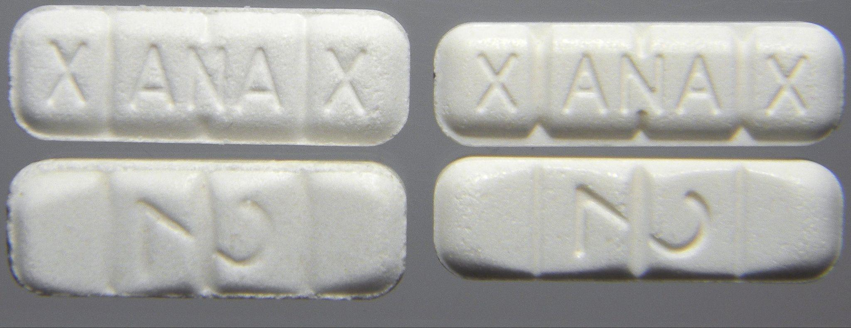
The rise in youth overdose death has been attributed to fentanyl lacing of counterfeit pills.
In 2021, fentanyls were identified in 77.14% of adolescent overdose deaths.
Can you spot the fake?
Source: Friedman, J. et al. (2022)
Notes:
Left is fake Xanax, Right is Pfizer. From Wall Street Journal https://www.wsj.com/articles/the-uphill-fight-against-fake-prescription-drugs-1539009351 Pfizer last year conducted a pilot with law enforcement testing 138 samples of Xanax purchased from the dark web and found only seven samples were authentic.

Slide 18
More Dangers to Youth
Adolescents most commonly reported use of alcohol, nicotine vaping, and cannabis in the past year.
The adolescent brain is still developing, particularly regions that regulate thoughts, emotions, and behavior.
These psychoactive substances can interfere with healthy development
Craving and tolerance can begin more rapidly than in adults.
Social media marketing is able to get around advertising regulations.
In 2021 about three in four (74%) students who used social media had seen e-cigarette–related posts or content.
Source: CDC (2024 and 2025), NIH (2023)

Slide 20
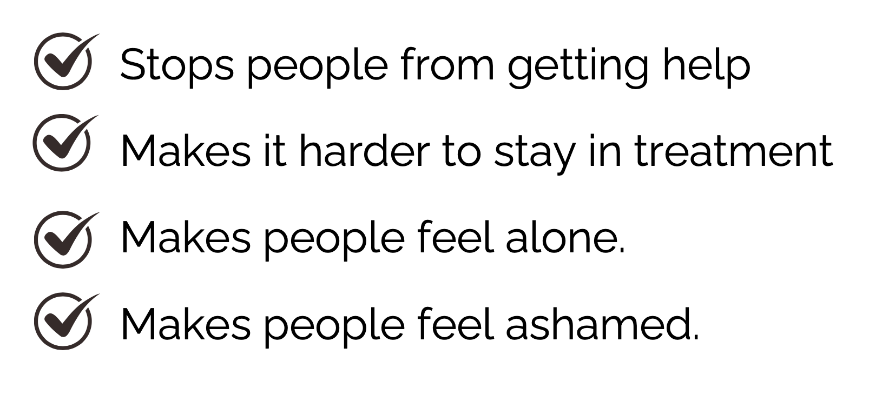
Consequences of Stigma
Stigma can make it harder for people to deal with substance abuse because it:

Slide 21
Can I Be Addicted to My Phone?
Technically there is no such thing as phone or internet addiction.
We can feel “addicted,” with some of those dependant feelings:
Craving, preoccupation, feeling angry when use is restricted, and frustration/conflict within the family.
Adolescence is a time of identity development, and there are some developmentally appropriate uses of online content:
Socializing and feeling valid, connecting to relevant communities, learning about oneself, shopping, schoolwork, etc.
Be careful not to pathologize normal adolescent development.
What looks like overuse may just be new ways of exploring, maintaining relationships, and pursuing interests.
Source: Child Mind Institute (2024), Ding, K. and Li, H. (2023)

Slide 22
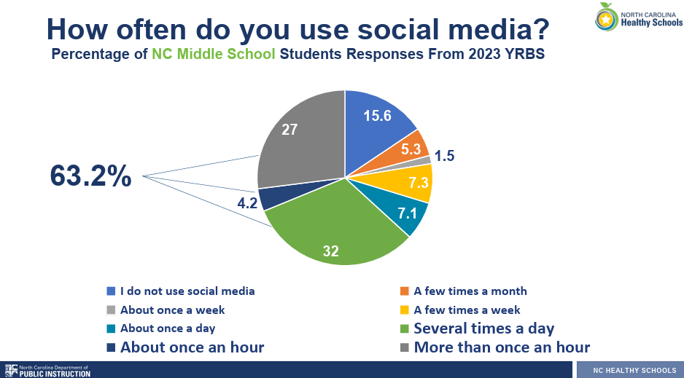
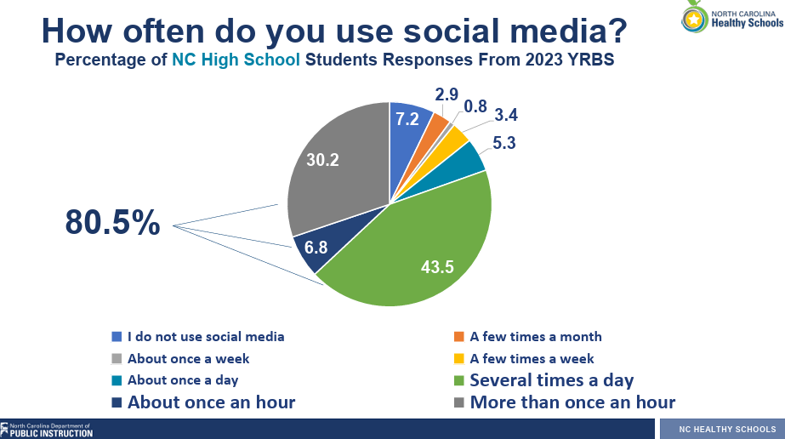
Technology Overuse
There are valid concerns about overuse of technology:
Children and adolescents’ brains are still developing, particularly the frontal lobes (responsible for self-control) this can make “addiction”/overuse more likely.
Apps/games are designed to keep users interested, and children and youth may find it hard to control the impulse.
Multitasking (using technology) while doing homework undermines learning.
Intense social media use increases anxiety and depression, especially in girls.
Excessive gaming (⅔ or more of free time) increases anxiety, depression, and substance use.
Use of tech in general takes away time from activities that are more valuable.
Source: Child Mind Institute (2024), Ding, K. and Li, H. (2023), NCDPI (2023)

Slide 23
New Guidelines for Media Use
We might wish for a simple solution or set of rules to follow, like the 2-hour screen time limit recommended in years past. But these don't address all of the things children and teens need to have a healthy relationship with media and to maintain emotional well-being.
The American Academy of Pediatrics (AAP) Center of Excellence (CoE) on Social Media and Youth Mental Health have developed a new approach.
Source: The American Academy of Pediatrics (AAP) Center of Excellence (CoE) on Social Media and Youth Mental Health

Slide 24
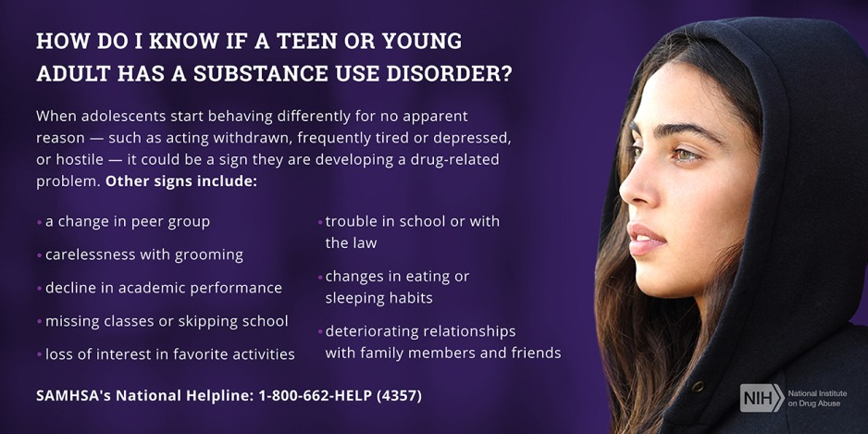
When to Seek Help
Functional Impact:
If using technology to the point of social isolation/withdrawal from other activities (friends, sports, schoolwork), it may be masking an underlying mental health condition.
If difficulty limiting use is causing friction in the family.
If repetitive use of any substance or behavior is causing problems with relationships, work or school, meeting personal needs, or otherwise harming physical health.

Slide 25
Evidence-Based Treatments Include:
Substance Use:
(A combination of treatments are most effective)
CRAFT - When individuals are reluctant to enter treatment, the therapist works with a concerned significant other.
Voucher-based programs - Work like a reward system to improve abstinence initially, then is combined with cognitive-behavior therapy (CBT) to maintain abstinence and prevent relapse
Relapse Prevention Therapy - A form of CBT that builds coping skills to deal with a lapse, and avoid risky situations.
Medication
For “Digital Addiction”:
CBT - Begins by creating a healthy internet use schedule, then helps to correct problematic thought patterns that justify excessive internet use, and addresses coexisting problems.
It's important that therapy also treat any underlying unmet needs (friendships, emotional problems, coping skills).
Family therapy - Addresses family dynamics and communication patterns to foster calm home environments that are more receptive to change.
Source: Ding, K. and Li, H. (2023)

Slide 26
How can I help?: Social Media
From APA
Model healthy social media use.
Use all parent controls to set time limits and control content.
Talk with kids about what they see and what is meaningful/real.
Look for signs that it might be interfering with psychological or physical
health (interferes with 8-9 hours of sleep, “real life” activities, etc.)
Teach social media literacy skills over time through a series of discussions as they grow and technology changes, and let them know they can come to you for support or concerns.
Source: APA (2023)

Slide 27
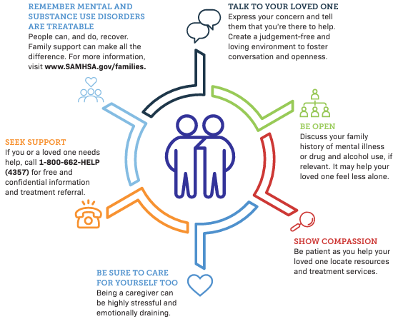
How can I Help?: Substance Use
Source: SAMHSA

Slide 28
Additional Resources
Resource guide for local therapists and additional resources are available at tables up front
Some brochures on talking with children and teens about substances
Laminated fliers with additional information you can look through
For those attending virtually - please reach out to Paul/Kara to get a copy.
Most, if not all, of these should be available for download on the website.
The Substance Abuse and Mental Health Services Administration (SAMHSA) operates the National Helpline 1-800-662-HELP (4357). This is a free, confidential, 24/7, 365-day-a-year treatment referral and information service (in English and Spanish). SAMHSA has resources available online for families coping with mental and substance use disorders and also provides a confidential online treatment locator.
If you or someone you know is in crisis:
Call or text 988 anytime to reach the Suicide and Crisis Lifeline
Text HOME to 741741 to reach the Crisis Text Line
Trevor Project suicide hotline for LGBTQ+ youth: Text START to 678678 or call 1-866-488-7386
Call 911 or go to local emergency department

Slide 29
Table Activity
Use the Question and Answer handouts to generate conversation here or at home.
Q & A on Social Media Use
Q & A on Drug Use
Family Values and Contracts
How to Talk to your Children and Teens

